Slide 1
CSS342 Data Structures, Algorithms, and Discrete Mathematics (I)

Slide 2

Recursion

Slide 3

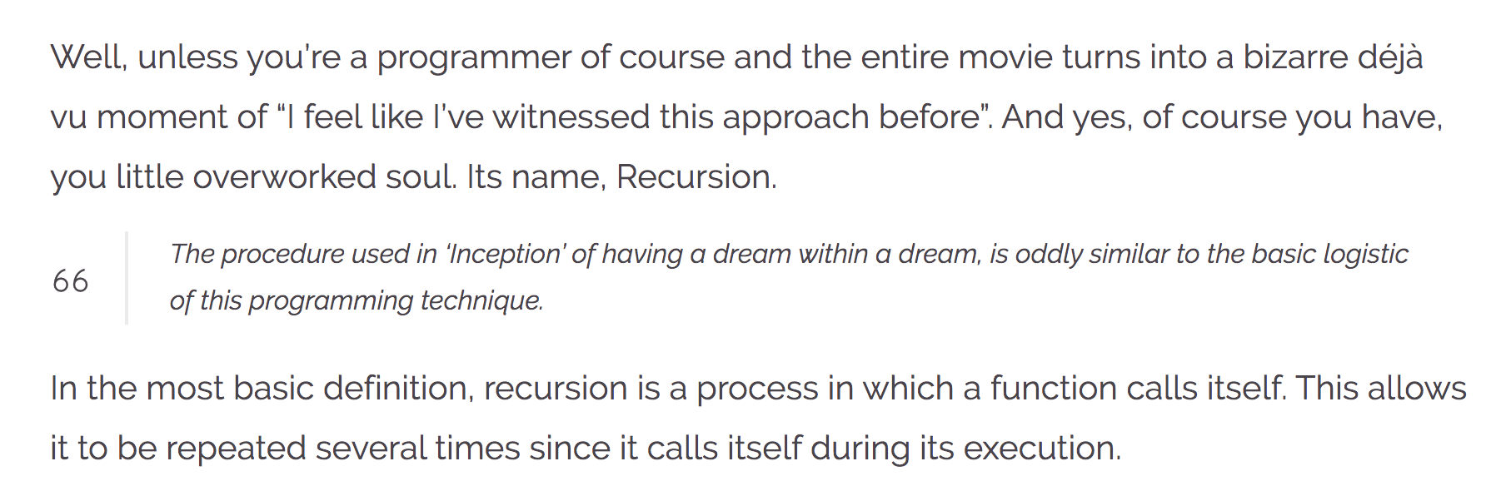
Recursion
https://wewrite.taleas.io/2018/11/14/why-inception-reminds-us-of-recursion/

Slide 4
Recursion

Slide 5
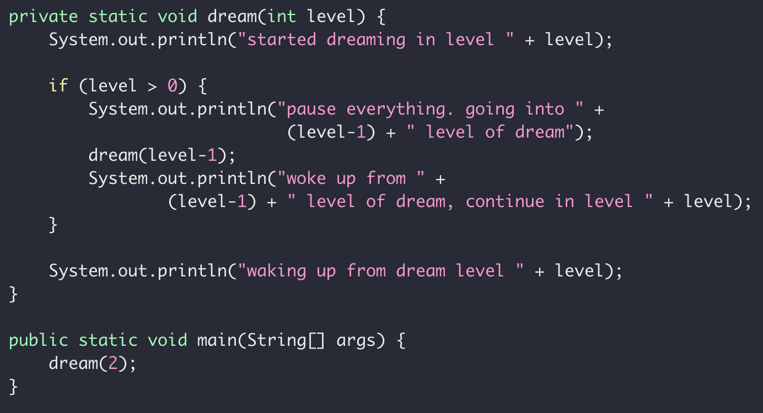
Dream in Dream
Level 2
Level 0
Level 0
Time

Slide 6
Dream in Recursion

Slide 7
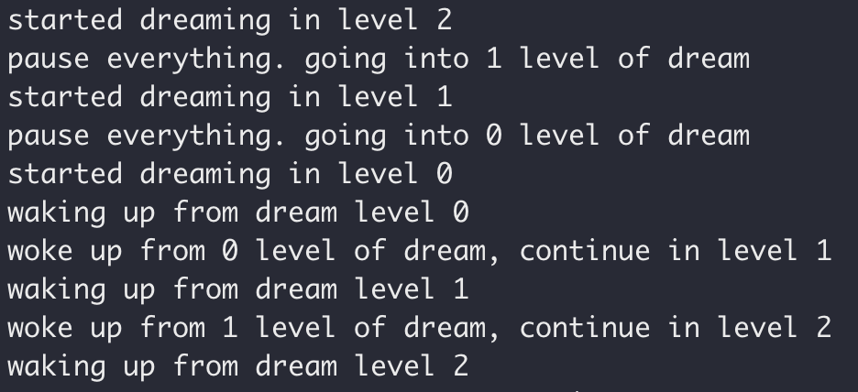
Dream in Recursion

Slide 8
Dream in Recursion

Slide 9
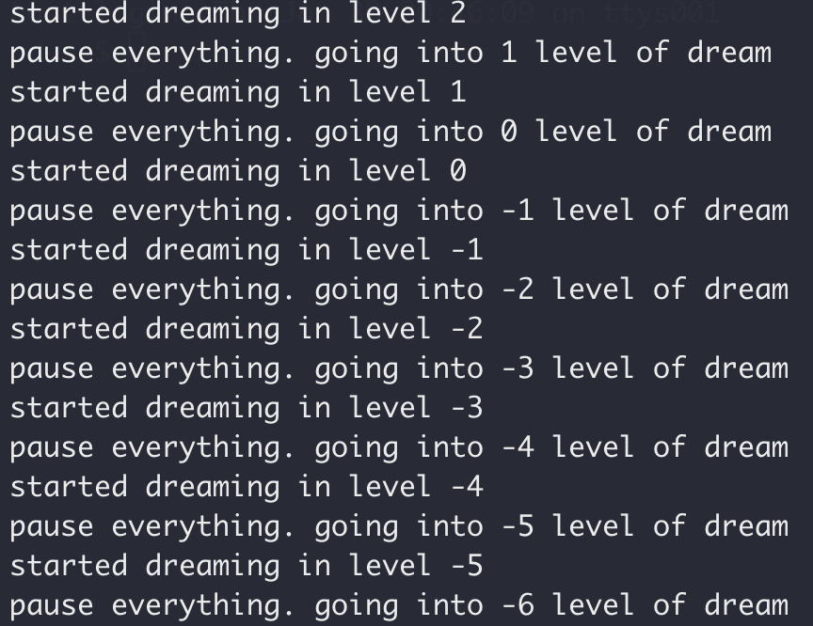
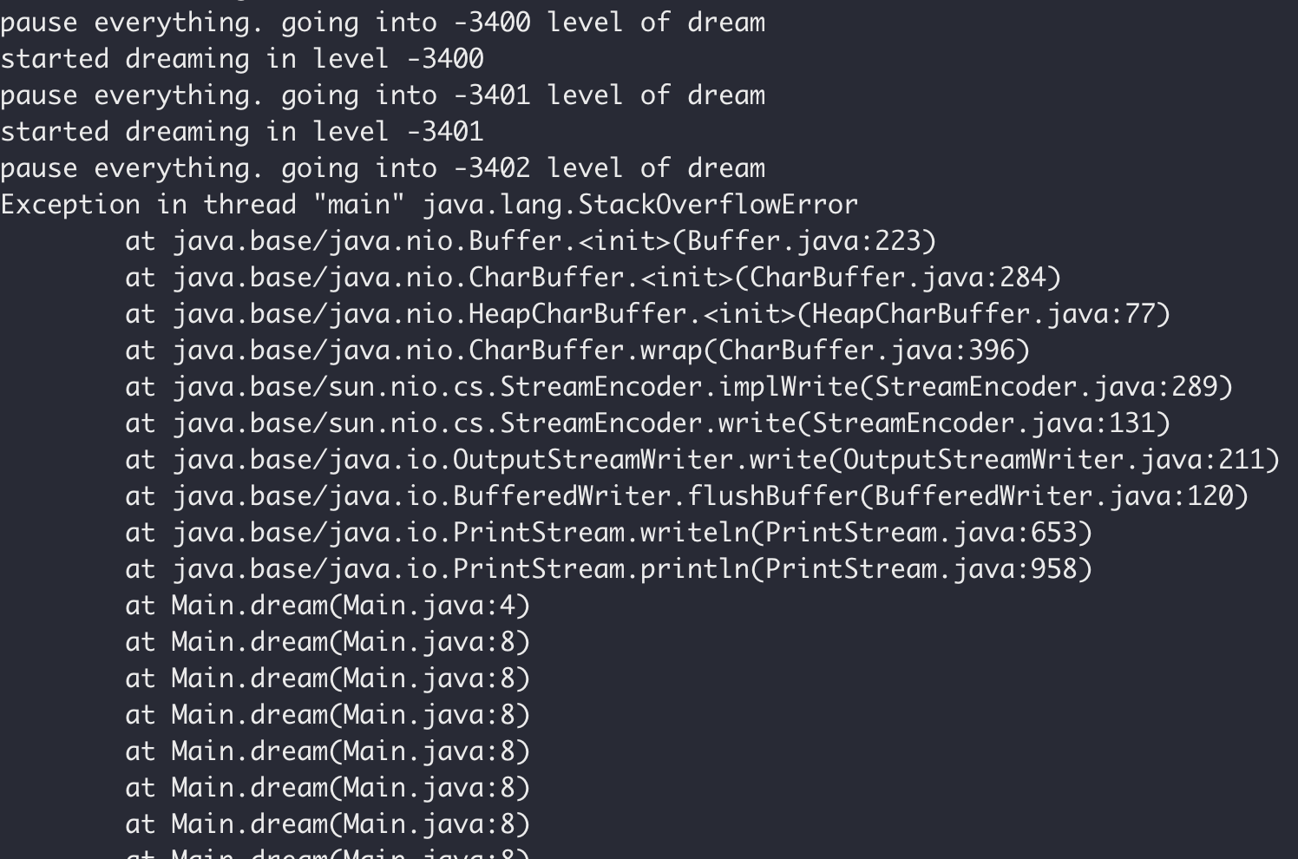
Dream in Recursion

Slide 10
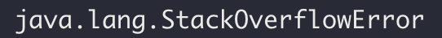
Dream in Recursion

Slide 11
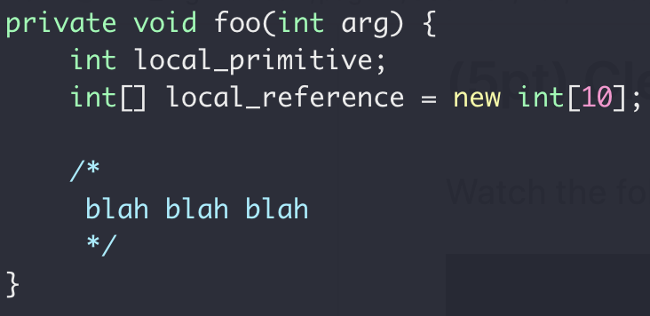
Function Call Stack
Heap
Int[10]
Stack
local_primitive
local_reference
Memory

Slide 12
Memory Map
Virtual Memory

Slide 13
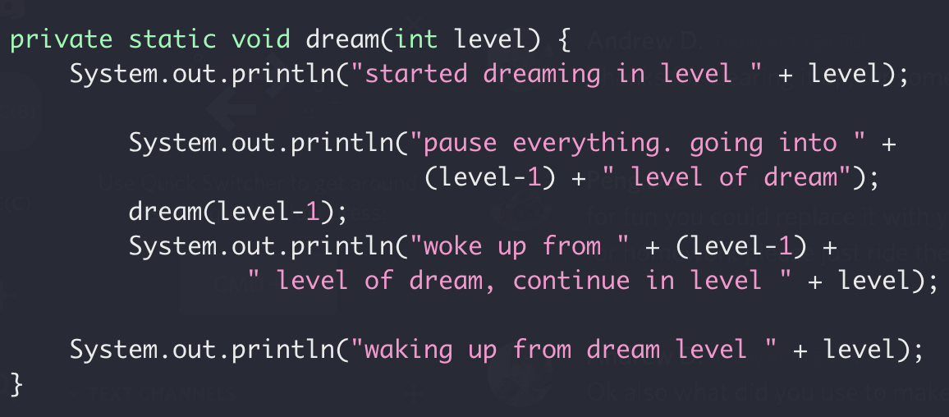
Function Call Stack
Heap
dream(2)
dream(1)
Locals for dream(0)
Return address of dream(1)
Locals for dream(1)
Stack
Return address of dream(2)
Locals for dream(2)
dream(0)
Return address of main()
Memory
More on function call
Stack buffer overflow attack
Notes:
http://www.pythontutor.com/visualize.html#mode=display

Slide 14
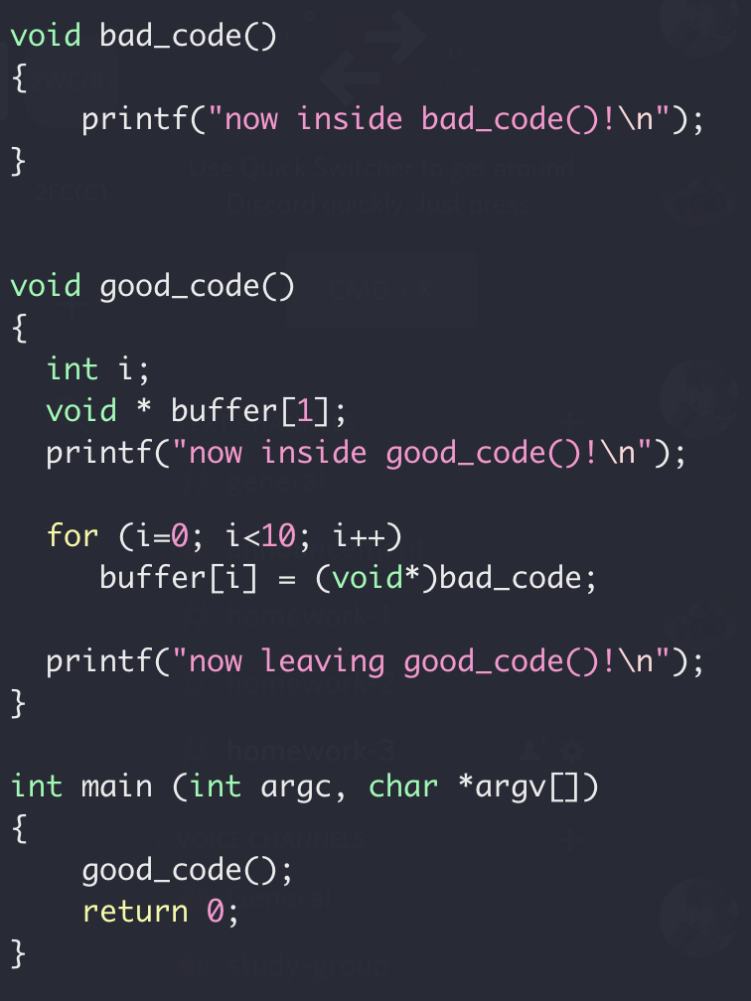
Function Call Stack
Locals for dream(1)
Stack
Return address of dream(2)
Locals for dream(2)
Return address of main()
Memory

Slide 15
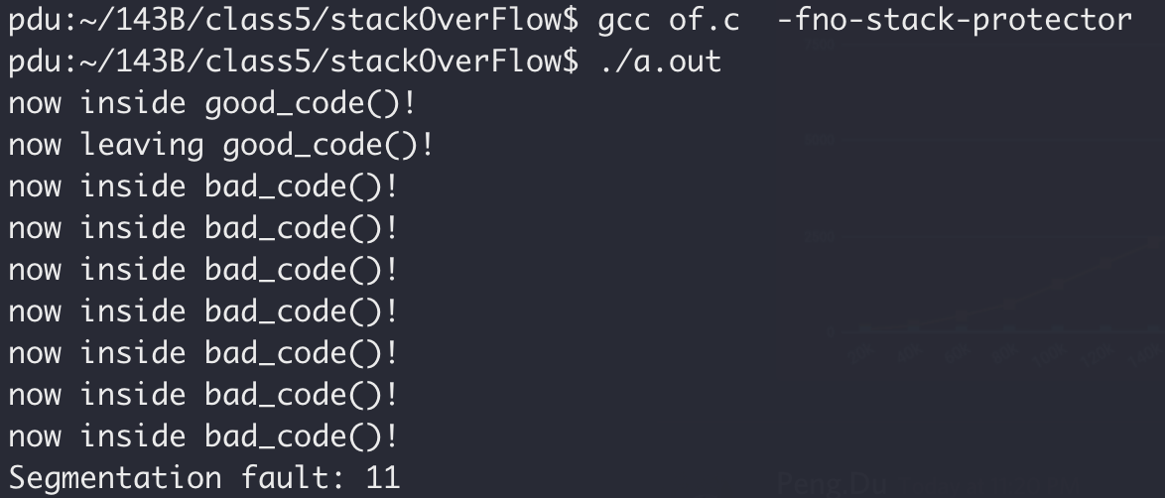
Function Call Stack
Stack smashing

Slide 16
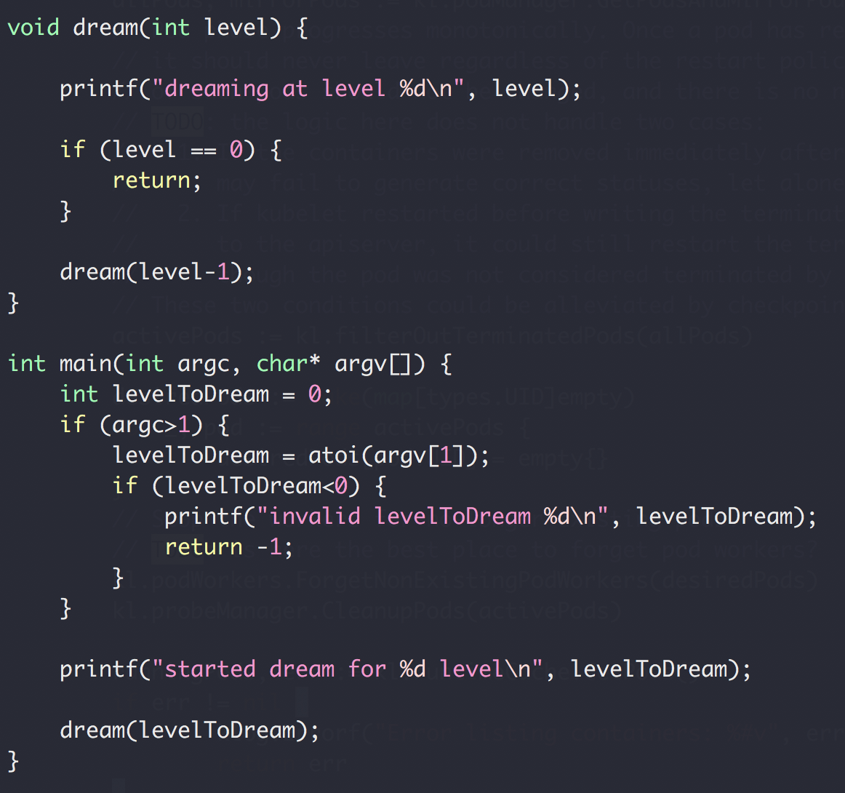
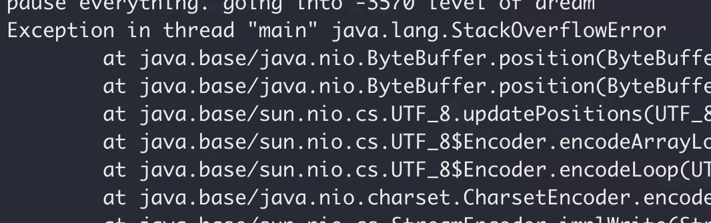
Function Call Stack
Heap
dream(N-4)
Return address of dream(N-3)
dream(N-3)
Return address of dream(N-2)
dream(N-2)
Return address of dream(N-1)
Stack
dream(N-1)
Return address of main()
main()
Memory

Slide 17
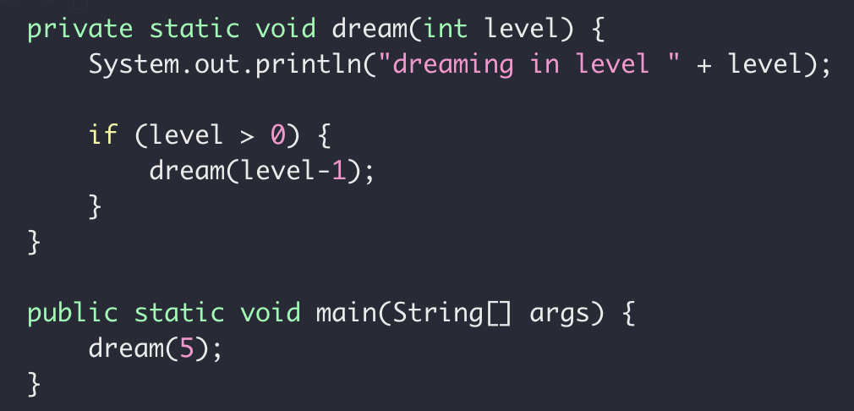
Recursion (and backtracking)
Recursion
Function Calling itself with different parameters (smaller subproblem)
Stop the recursion when the subproblem is ”small enough”
solved directly

Slide 18
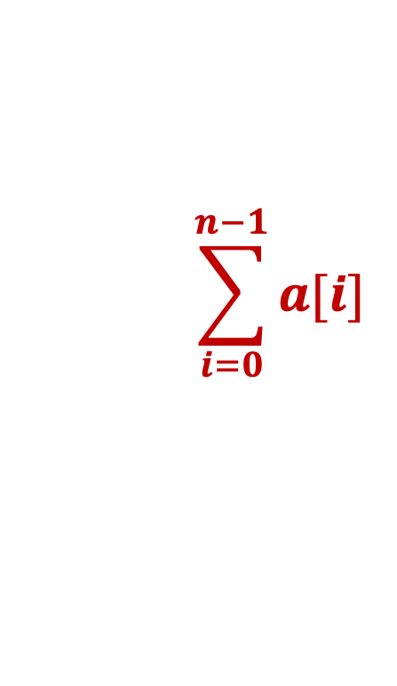
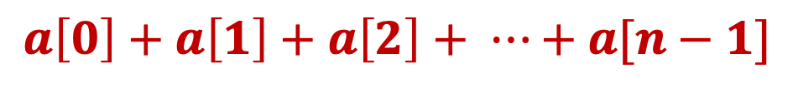
Recursive Sum
Write a function to get the sum of an integer array
$$a\left[0\right]+a\left[1\right]+a\left[2\right]+ ⋯+a[n−1]$$
$$\sum_{i=0}^{n−1}{a[i]}$$

Slide 19
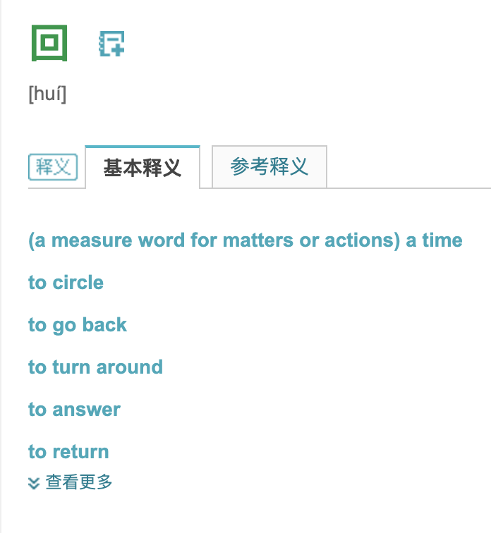
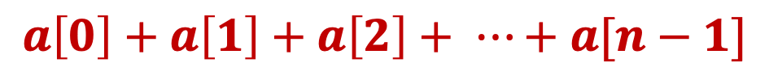
Recursive Sum
Write a function to get the sum of an integer array
$$a\left[0\right]+a\left[1\right]+a\left[2\right]+ ⋯+a[n−1]$$

Slide 20
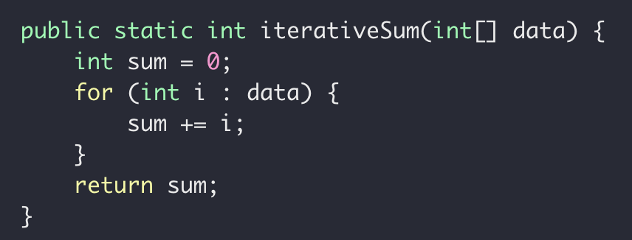
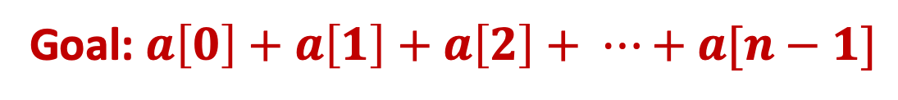
Recursive Sum
Goal: $a\left[0\right]+a\left[1\right]+a\left[2\right]+ ⋯+a[n−1]$
Iteratively

Slide 21
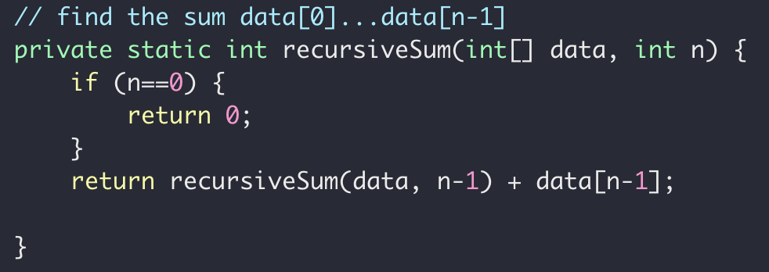
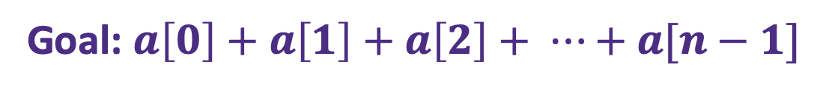


Recursive Sum
Goal: $a\left[0\right]+a\left[1\right]+a\left[2\right]+ ⋯+a[n−1]$
$sum\left(n\right)=a\left[0\right]+a\left[1\right]+ ⋯+a[n−2]+a[n−1]$
Problem
Sub-problem
$sum\left(n−1\right)=a\left[0\right]+a\left[1\right]+ ⋯+a[n−2]$
$sum\left(n−1\right)=a\left[0\right]+a\left[1\right]+ ⋯+a[n−2]$
$sum\left(n−1\right)= ?$
$sum\left(n\right)=sum(n−1)+a[n−1]$

Slide 22
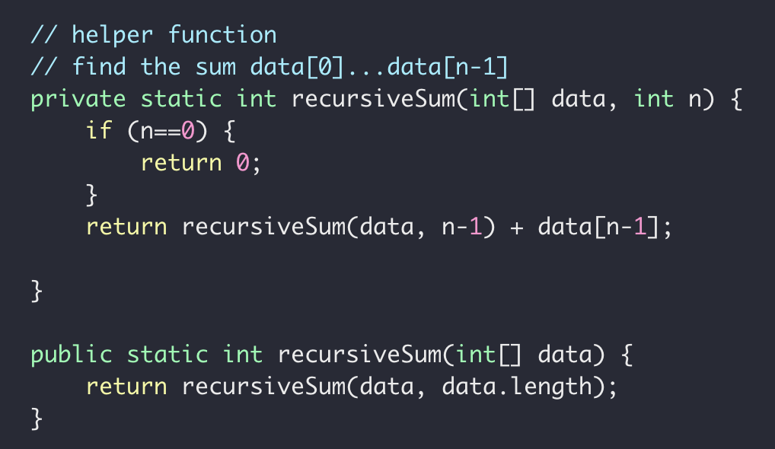
Recursive Sum
Goal: $a\left[0\right]+a\left[1\right]+a\left[2\right]+ ⋯+a[n−1]$

Slide 23




Recursive Sum
$$int \left[ \right] a=[5, 6,7,8]$$
Sum(data, 3)
Sum(data, 2)
$$=a\left[3\right]+$$
Sum(data, 1)
$$=a\left[2\right]+$$
Sum(data, 0)
$$=a\left[1\right]+$$

Slide 24
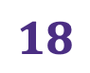






Recursive Sum
$$int \left[ \right] a=[5, 6,7,8]$$
Sum(data, 3)
$$=26$$
Sum(data, 2)
$$=8+$$
$$18$$
Sum(data, 1)
$$=7+$$
$$11$$
Sum(data, 0)
$$=6+$$
$$5$$

Slide 25
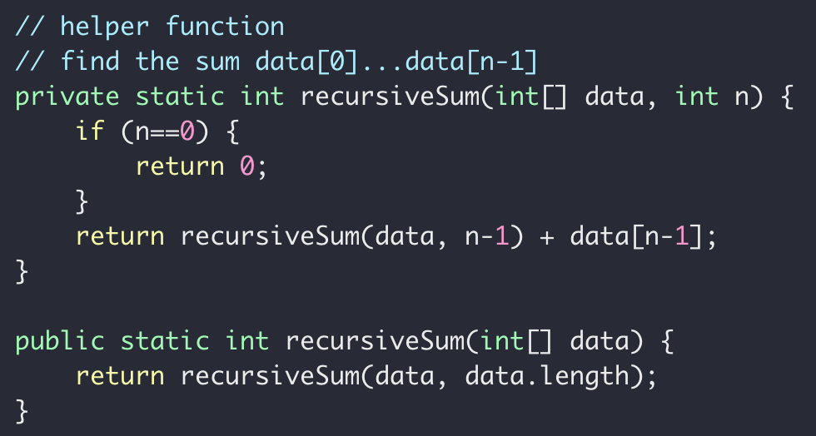
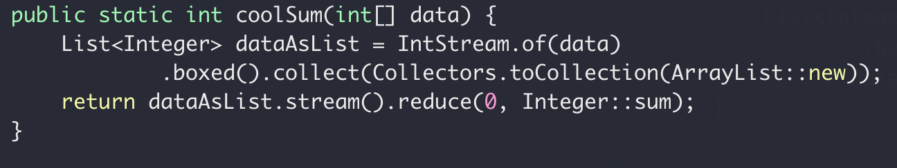

Recursive Sum
Goal: $a\left[0\right]+a\left[1\right]+a\left[2\right]+ ⋯+a[n−1]$
iterative
recursive
“modern”

Slide 26


Recursive Sum
Goal: $a\left[0\right]+a\left[1\right]+a\left[2\right]+ ⋯+a[n−1]$
Sum(data, n)
Sum(data, n-1)
$$=a\left[n−1\right]+$$
$sum\left(n\right)=a\left[n−1\right]+sum(n−1)$

Slide 27
Recursive findMax
Write a function to get the maximum of an int array
12
12
1
7
18
18
10
3
0
1
2
3
4
5
6

Slide 28
Recursion (and backtracking)
How to find the largest apple
In box 0 to 5
0
1
2
3
4
5
Largest apple:
1
1
0

Slide 29
Recursion (and backtracking)
How to find the largest apple
In box 0 to 5 (noted as [0,5])
Get the first apple from [0,5]
Find the largest apple from [1,5]
compare it with apple 0
0
1
2
3
4
5

Slide 30
Recursion (and backtracking)
How to find the largest apple
In box 1 to 5
Get the first apple from [1,5]
Find the largest apple from 2-5
compare it with apple 1
0
1
2
3
4
5

Slide 31
Recursion (and backtracking)
How to find the largest apple
In box 2 to 5
Get the first apple from [2,5]
Find the largest apple from 3-5
compare it with apple 2
0
1
2
3
4
5

Slide 32
Recursion (and backtracking)
How to find the largest apple
In box 1 to 5
Get the first apple from [3,5]
Find the largest apple from 3-5
compare it with apple 3
0
1
2
3
4
5

Slide 33
Recursion (and backtracking)
How to find the largest apple
In box 1 to 5
Get the first apple from [4,5]
Find the largest apple from 4-5
compare it with apple 4
0
1
2
3
4
5

Slide 34
Recursion (and backtracking)
How to find the largest apple
In box 1 to 5
Only 1 apple is left, it’s the largest comparing to itself
0
1
2
3
4
5

Slide 35
Recursion (and backtracking)
How to find the largest apple
In box 1 to 5
Get the first apple from [4,5]
Find the largest apple from 4-5
compare it with apple 4
0
1
2
3
4
5

Slide 36
Recursion (and backtracking)
How to find the largest apple
In box 1 to 5
Get the first apple from [4,5]
Find the largest apple from 4-5
compare it with apple 4
0
1
2
3
4
5

Slide 37
Recursion (and backtracking)
How to find the largest apple
In box 1 to 5
Get the first apple from [3,5]
Find the largest apple from 3-5
compare it with apple 3
0
1
2
3
4
5

Slide 38
Recursion (and backtracking)
How to find the largest apple
In box 1 to 5
Get the first apple from [3,5]
Find the largest apple from 3-5
compare it with apple 3
0
1
2
3
4
5

Slide 39
Recursion (and backtracking)
How to find the largest apple
In box 2 to 5
Get the first apple from [2,5]
Find the largest apple from 3-5
compare it with apple 2
0
1
2
3
4
5

Slide 40
Recursion (and backtracking)
How to find the largest apple
In box 1 to 5
Get the first apple from [1,5]
Find the largest apple from 2-5
compare it with apple 1
0
1
2
3
4
5

Slide 41
Recursion (and backtracking)
How to find the largest apple
In box 1 to 5
Get the first apple from [1,5]
Find the largest apple from 2-5
compare it with apple 1
0
1
2
3
4
5

Slide 42
Recursion (and backtracking)
How to find the largest apple
In box 1 to 5
Get the first apple from [1,5]
Find the largest apple from 2-5
compare it with apple 1
0
1
2
3
4
5

Slide 43
Recursion (and backtracking)
How to find the largest apple
In box 0 to 5 (noted as [0,5])
Get the first apple from [0,5]
Find the largest apple from [1,5]
compare it with apple 0
0
1
2
3
4
5

Slide 44
Recursion (and backtracking)
How to find the largest apple
In box 0 to 5 (noted as [0,5])
Get the first apple from [0,5]
Find the largest apple from [1,5]
compare it with apple 0
0
1
2
3
4
5

Slide 45
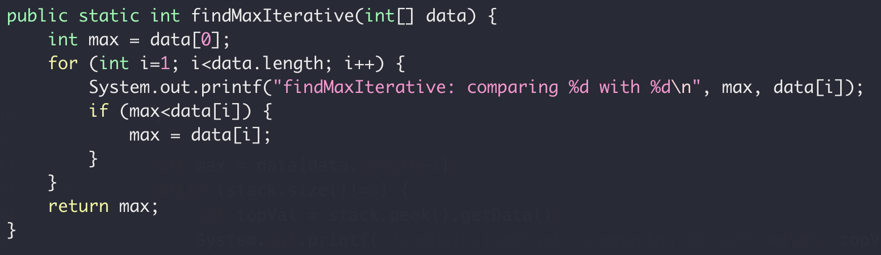
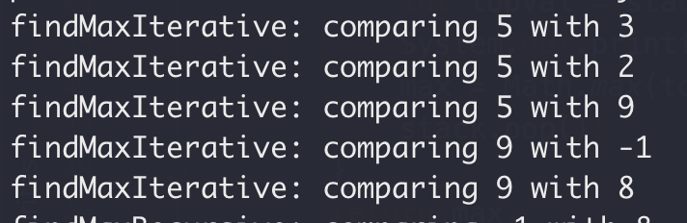
Recursive Max
Iteratively
5
3
2
9
-1
8
0
1
2
3
4
5

Slide 46
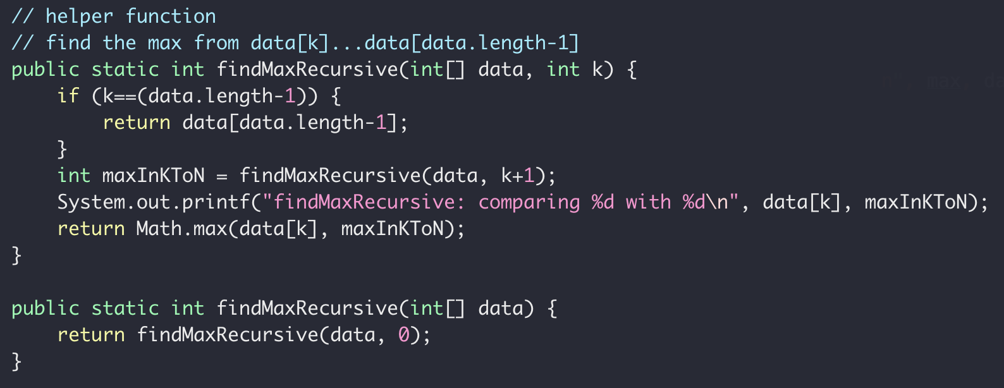
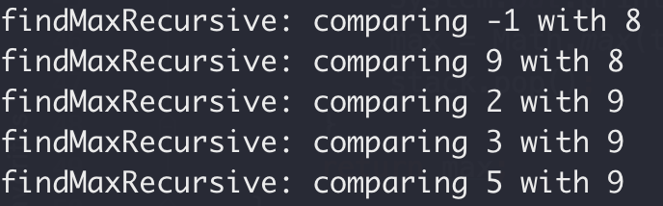
Recursive Max
5
3
2
9
-1
8
0
1
2
3
4
5
Recursively

Slide 47
Recursive Linked List Print
Print linked list values backward
inplace
head
8
3
2
9
5
6
null
6, 5, 9, 2, 3, 8

Slide 48
Recursive Linked List Print
8
3->…->6
head
3
2
9
5
6
r(8->…->6) = r(3->…->6) + “8”
null
3
2->…->6
2
9
5
6
null
r(3->2->…->6) = r(2->…->6) + “3”

Slide 49
Recursive Linked List Print
2
9->…->6
9
5
6
null
r(2->…->6) = r(9->…->6) + “2”
9
5->6
5
6
null
r(9->…->6) = r(5->6) + “9”
5
6
6
null
r(5->6) = r(5)+“6”

Slide 50
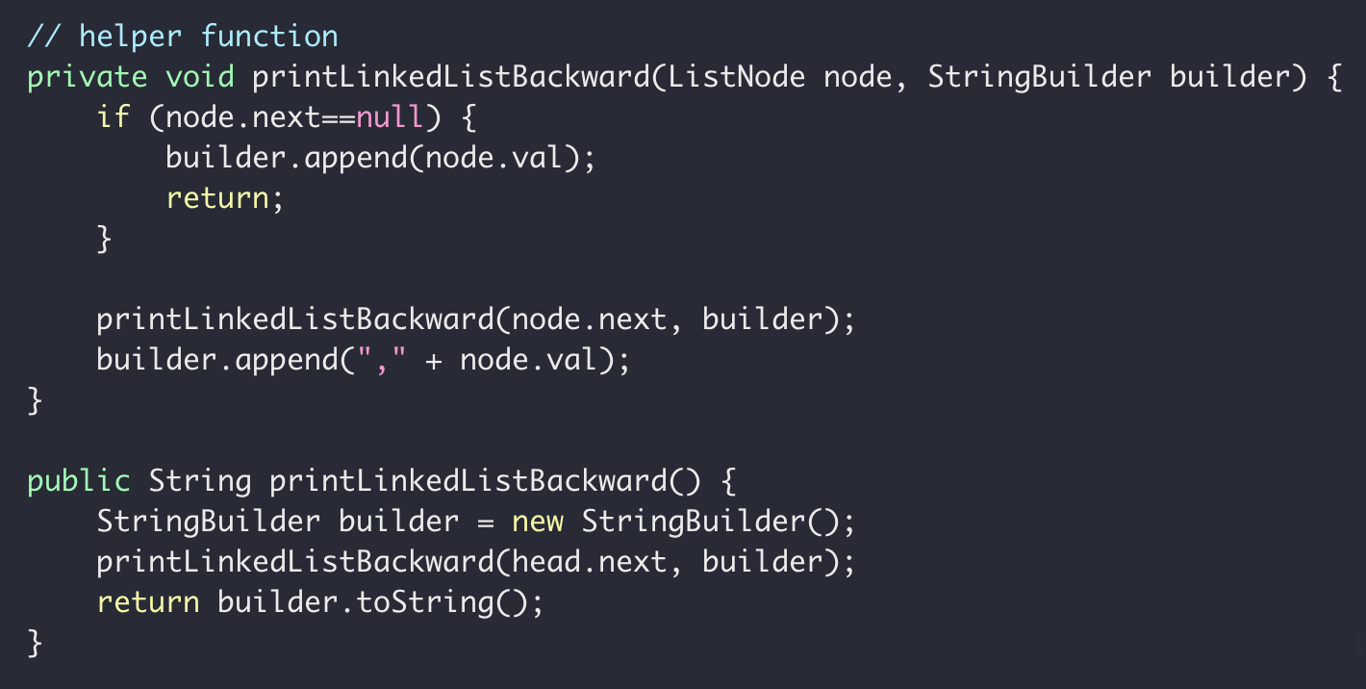
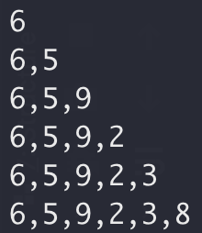
Recursive Linked List Print
builder
But can you do this without recursion?

Slide 51
Recursive Linked List Print
head
8
3
2
9
5
6
null
Visit
Print
Visit 8 first
FILO
STACK!!
Print 8 fast
builder

Slide 52
Recursive Linked List Print
builder
But can you do this without recursion?

Slide 53
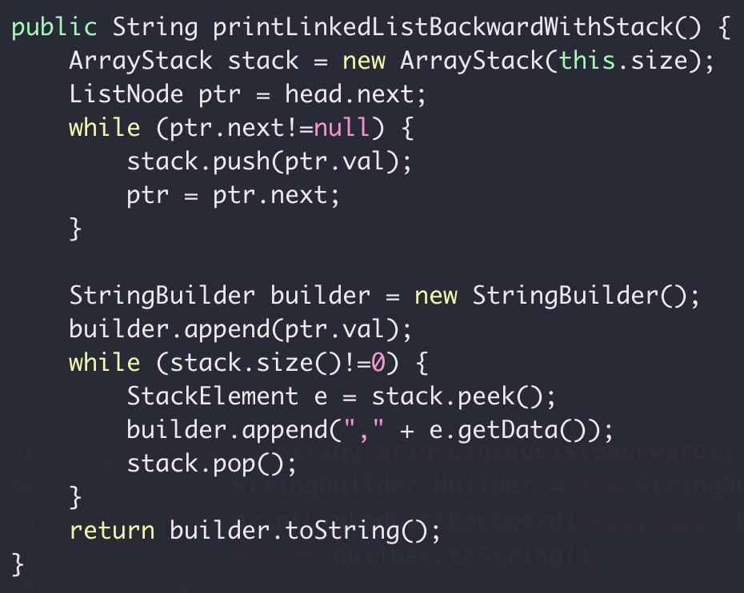
Wednesday
builder

Slide 54
Recursive Linked List Print
head
8
3
2
9
5
6
null
Return address
node.val
Stack
Return address
node.val
Return address

Slide 55
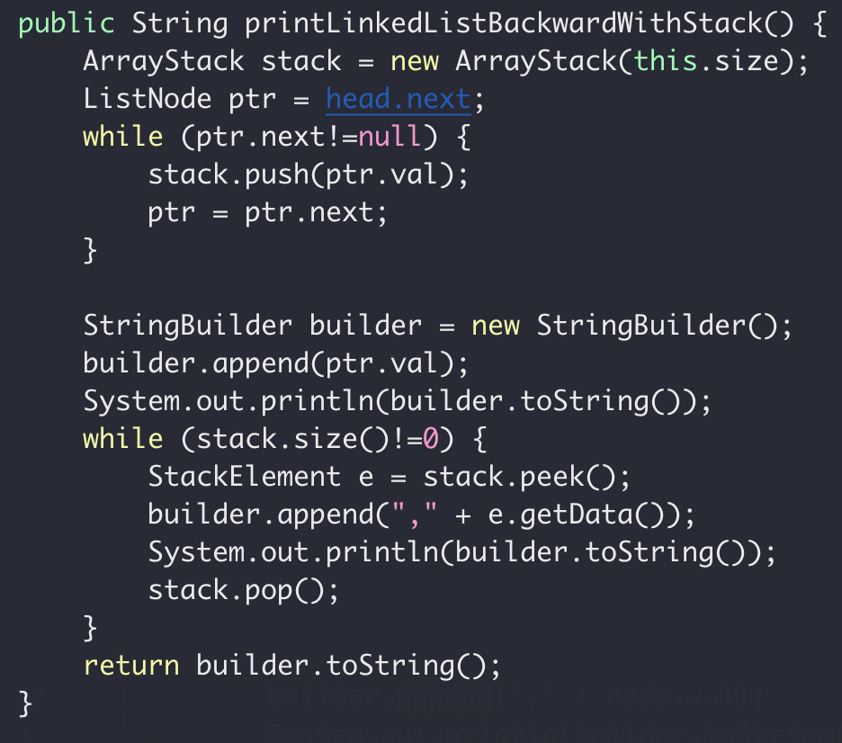
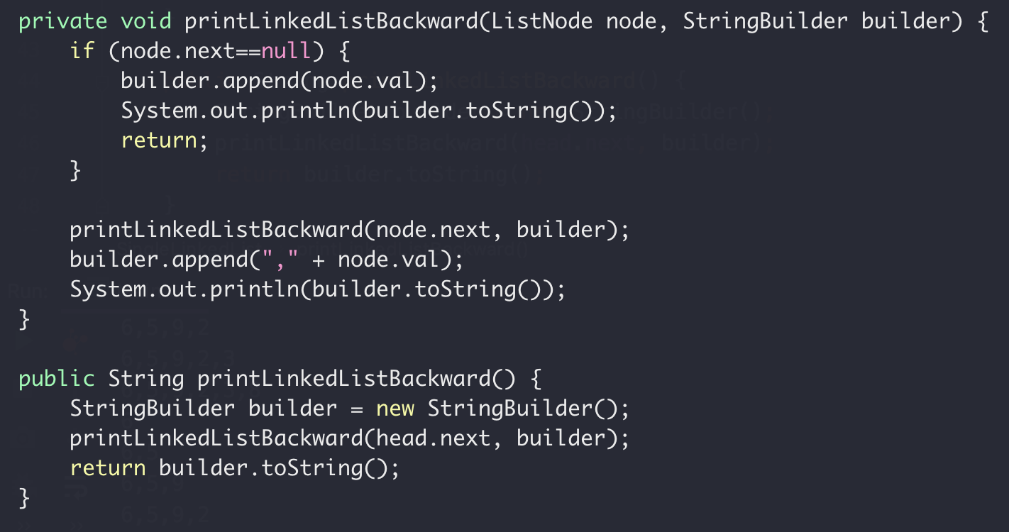
Recursive Summary
Recursion
Iterative + Stack

Slide 56

Recursive Summary
Smell of Recursion
Solution ← Solution of a subproblem
$sum\left(n\right)=a\left[n−1\right]+sum(n−1)$
Depth First Visit
head
8
3
2
9
5
6
null
Visit

Slide 57

Recursion
“you never really remember
the beginning of a dream, do you?”
$−$ Inception

Slide 58
Wednesday

Slide 59
Recursion
Binary Search
Linear Search (target 12)
5 3 1 9 8 7 12 2 4
5 3 1 8 7 9 2 4 12
O(N) Can we do better?
Worse case we have to iterate N element

Slide 60
Binary Search
“Who checked that bug in?!!”
Source control svn, git, etc
1
2
3
4
5
6
7
8
9
10
Mike
Peng
Ethan

Slide 61

Binary Search
“Who checked that bug in?!!”
Source control svn, git, etc
Found a bug in version 10
No bug in version 1
?
?
?
?
?
?
?
?
1
2
3
4
5
6
7
8
9
10

Slide 62
Binary Search
Source control svn, git, etc
“Who checked that bug in?!!”
Found a bug in version 10
No bug in version 1
?
?
?
?
?
?
?
?
1
2
3
4
5
6
7
8
9
10

Slide 63
Binary Search
Source control svn, git, etc
“Who checked that bug in?!!”
Found a bug in version 10
No bug in version 1
?
?
?
?
?
?
?
?
1
2
3
4
5
6
7
8
9
10

Slide 64
Binary Search
Source control svn, git, etc
“Who checked that bug in?!!”
Found a bug in version 10
No bug in version 1
?
?
?
?
?
1
2
3
4
5
6
7
8
9
10
Bug introduced, found with 3 checks

Slide 65
Binary Search
Binary Search (target 12)
1 2 3 4 5 7 8 9 12
1 2 3 4 5 7 8 9 12
1 2 3 4 5 7 8 9 12
1 2 3 4 5 7 8 9 12
1 2 3 4 5 7 8 9 12
O(logN) both average and worst case

Slide 66
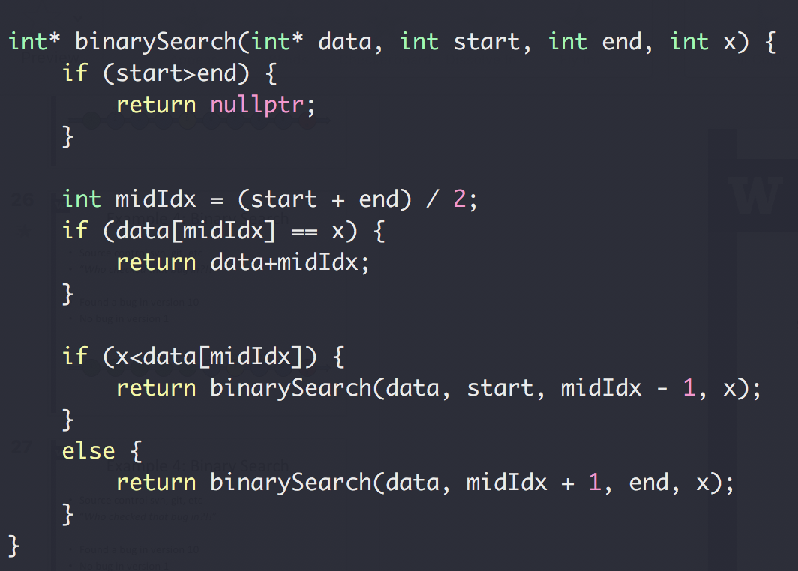
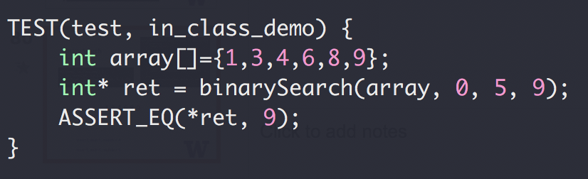
Binary Search

Slide 67
Binary Search
1,3,4,6,8,9
start=0, end=5, midIdx = 2
start=3, end=5, midIdx = 4
start=5, end=5, midIdx = 5

Slide 68
Binary Search
Up to 2³¹-1 for 32-bit signed int
What could go wrong?
The Java programming language library had this bug for 20+ years

Slide 69
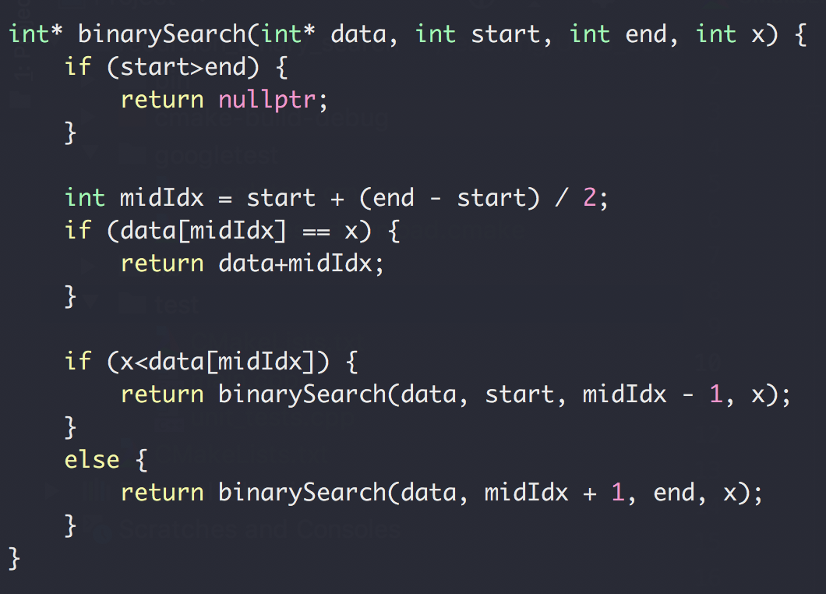
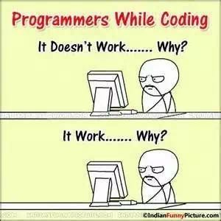
Binary Search

Slide 70
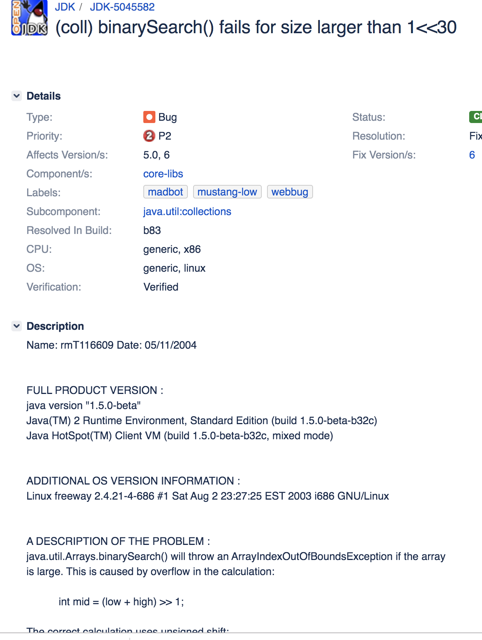
Binary Search
https://bugs.openjdk.java.net/browse/JDK-5045582

